Slide 1

Business-Government Relations
Chapter 7
©20XX McGraw-Hill Education. All rights reserved. Authorized only for instructor use in the classroom. No reproduction or further distribution permitted without the prior written consent of McGraw-Hill Education.

Slide 2

How Business and Government Relate
Seeking a collaborative partnership
Working in opposition to government
Legitimacy issues
Public policy
Notes:
Seeking a collaborative partnership
Government cooperates with business for mutually beneficial goals.
Influenced by nation’s values and customs.
Working in opposition to government
Government’s goals and business’s objectives are in conflict and results in an adversarial relationship.
Legitimacy issues
Companies operating globally may find governments whose legitimacy or right to be in power is questioned.
Public policy: A plan of action undertaken by government officials to achieve some broad purpose affecting a substantial segment of a nation’s citizens.
Public policy sets the goals, plans, and actions that each national government follows in achieving its purposes.

Slide 3

Elements of Public Policy
1. Public policy inputs
2. Public policy goals
3. Public policy tools
4. Public policy effects
Notes:
Public policy inputs: external pressures that shape a government’s policy decisions and strategies to address problems.
Public policy goals: can be broad and high-minded or narrow and self-serving.
Public policy tools: incentives and penalties that government uses to achieve policy goals.
Public policy effects: the outcomes arising from government regulation.

Slide 4

Types of Public Policy: Economic1
Economic policies
Fiscal policy
Monetary policy
Other types of economic policies
Social assistance policies
Notes:
Economic policies
Fiscal policy: patterns of government collecting and spending funds to stimulate or support the economy.
Monetary policy: policies that affect the supply, demand, and value of a nation’s currency.
Other types of economic policies:
Taxation policy: Raising or lowering taxes on business or individuals.
Industrial policy: Directing economic resources toward the development of specific industries.
Trade policy: Encouraging or discouraging trade with other countries.
Social assistance policies
Policies that concern social services for citizens.
→ Example: health care and education

Slide 5

Government Regulation of Business1
What is Regulation
Reasons for regulation
  Market failure
  Negative externalities
  Natural monopolies
  Ethical arguments
Notes:
Regulation
The action of government to establish rules of conduct for citizens and organizations.
It is a primary way of accomplishing public policy.
Reasons for regulation
Market failure: marketplace fails to adjust prices for the true costs of a firm’s behavior.
→ Example: EU standards for food contamination.
Negative externalities: the manufacture or distribution of a product gives rise to unplanned or unintended costs (spillover effects).
Natural monopolies: without competition, firms could raise prices as much as they want.
→ Example: electric utility services.
Ethical arguments: consequences, fairness issues.
→ Example: the recent UK Modern Slavery Act

Slide 6

Types of Regulations:
Economic regulations
Antitrust: A Special Kind of Economic Regulation
Social regulations
Notes:
Economic regulations . Aim to modify the normal operation of the free market and the forces of supply and demand; the oldest form of regulation. Includes regulations that
Control prices or wages.
Allocate public resources.
Establish service territories.
Set the number of participants.
Ration resources.
Antitrust - A Special Kind of Economic Regulation
Antitrust laws prohibit unfair, anticompetitive practices by business.
→ Example: The AT&T – Time Warner Merger of 2018.
Predatory pricing
The practice of selling below cost to drive rivals out of business.
Two main antitrust enforcement agencies
Antitrust Division of the U.S. Department of Justice.
Federal Trade Commission.
Social regulations
Aimed at such important social goals as protecting consumers and the environment and providing workers with safe and healthy working conditions.
Includes regulations which apply to all businesses:
Equal employment opportunity.
Protection of pension benefits.
Health care for all citizens.
Pollution control.
Safety and health concerns.

Slide 7
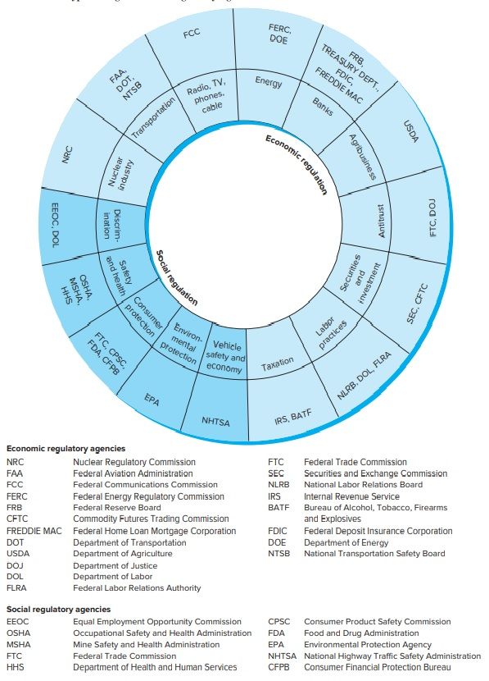
Types of Regulation & Regulatory Agencies
Copyright © McGraw-Hill Education, Permission required for reproduction or display.
Figure 7.1
Access the text alternative for these images.

Slide 8


The Effects of Regulation1
Government hopes that the benefits arising from regulation outweigh the
costs.
The Costs and Benefits of Regulation
Continuous Regulatory Reform
Notes:
Government hopes that the benefits arising from regulation outweigh the
costs.
The Costs and Benefits of Regulation
Cost-benefit analysis helps the public understand what is at stake when new regulation is sought.
Continuous Regulatory Reform
Deregulation: the removal or scaling down regulatory activities of government.
Example: Deregulation in the United States, starting in 2017.
Reregulation: the expansion of government regulation.
Example: Reregulation of the securities and financial services industries in the 2000s.

Slide 9
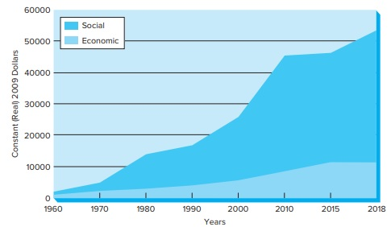
Spending on U.S. Regulatory Activities
Copyright © McGraw-Hill Education, Permission required for reproduction or display.
Figure 7.2
Access the text alternative for these images.

Slide 10

Regulation in a Global Context
Government established rules to protect the interests of the their citizens.
  International regulatory agreements and cooperation.
Sometimes, nations negotiate agreements directly with one another.
Sometimes, they do so under the auspices of the United Nations or regional alliances.
Notes:
Regulation in a Global Context
Government established rules to protect the interests of the their citizens.
International regulatory agreements and cooperation.
Sometimes, nations negotiate agreements directly with one another.
Sometimes, they do so under the auspices of the United Nations or regional alliances.

Slide 11
Business-Government Relations
Chapter 7
©20XX McGraw-Hill Education. All rights reserved. Authorized only for instructor use in the classroom. No reproduction or further distribution permitted without the prior written consent of McGraw-Hill Education.

